Slide 1

WEB 3.0: a wider perception
Simanovsky Sergey
blocksult.com

Slide 2
23% of the internet is free (Freedom house)
47% of world population have some social media blocked (Internet trends)
42% of world population have internet cuts due to political reasons (Internet trends)
Russia, China, USA, Germany, Kazakhstan, New Zealand, Australia, UK, Iran… and many more countries have some kind of internet restriction laws

Slide 3
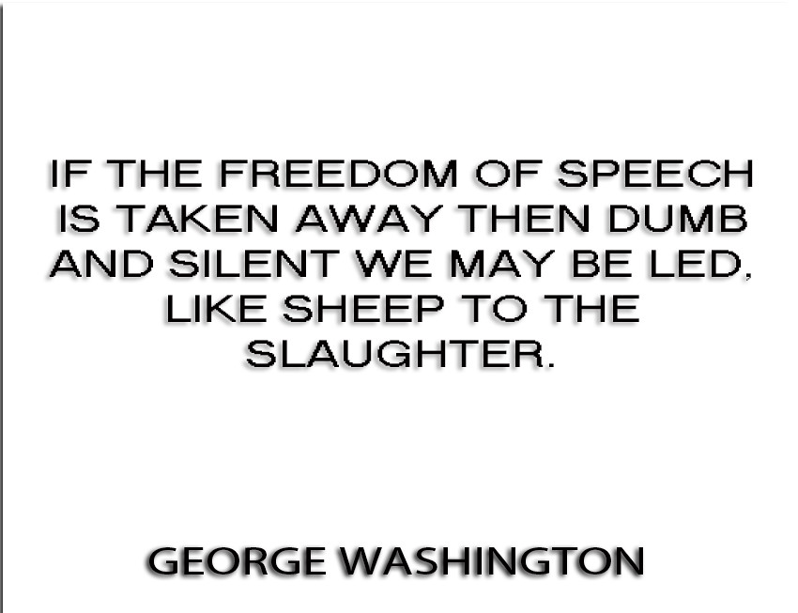

Slide 4
“Web 3.0 has started to emerge as a movement away from the centralisation of services like search, social media and chat applications that are dependent on a single organisation to function” (Wiki)
“...an independent (deriving from the word “independence” here, as in - not controlled by third parties) communication of one to another, between applications, bots, software (and not JUST software) and the humans behind it…”
What web 4.0 might become: “...an automatic gearbox, meaning that no one had control over it and no one makes the decisions for themselves!”

Slide 5
Web 1.0:
- Static
- Slow connection
- Computer Illiteracy
- HTML
- Resource consumption
Web 2.0:
UI
Social media
User interaction
High speed internet
Applications

Slide 6
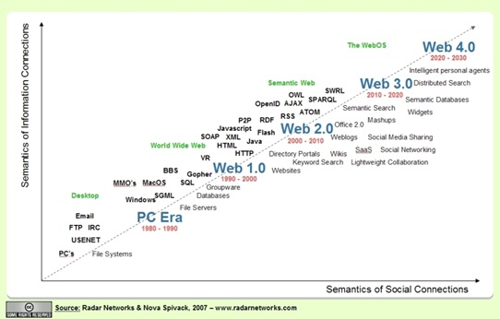
Progress?

Slide 7
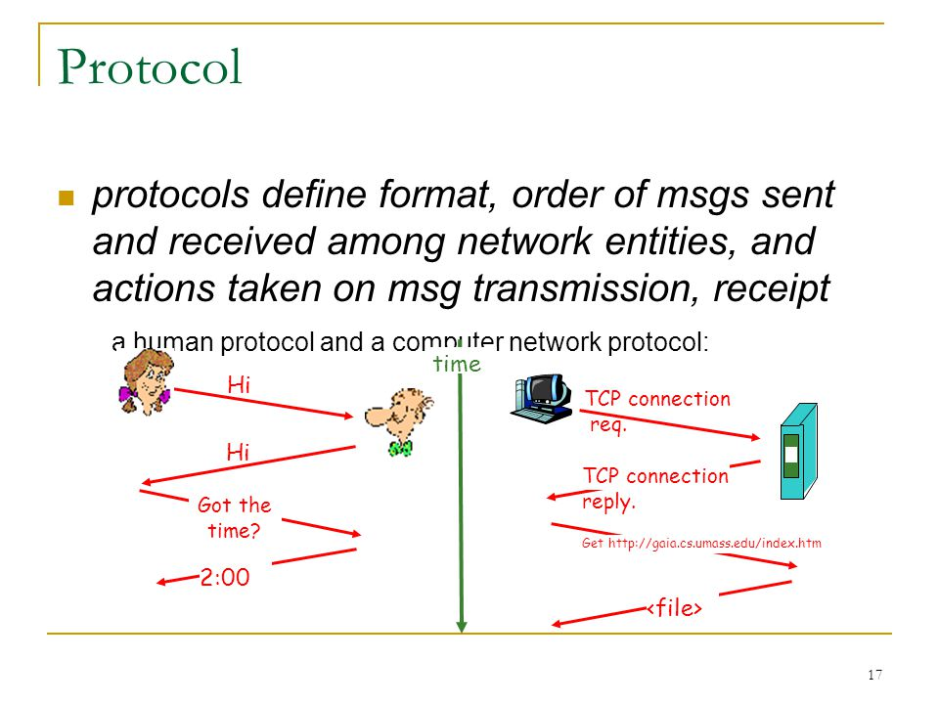

Slide 8
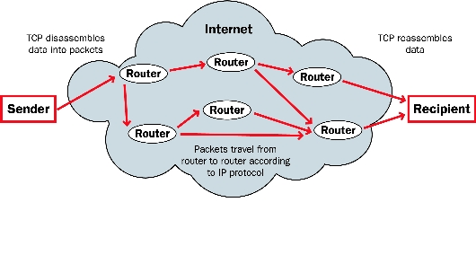
ROUTING
FIle in place A get subdivided into packets by a protocol
The packets have arrived at their new destination
The protocol has reassembled the files in place B

Slide 9
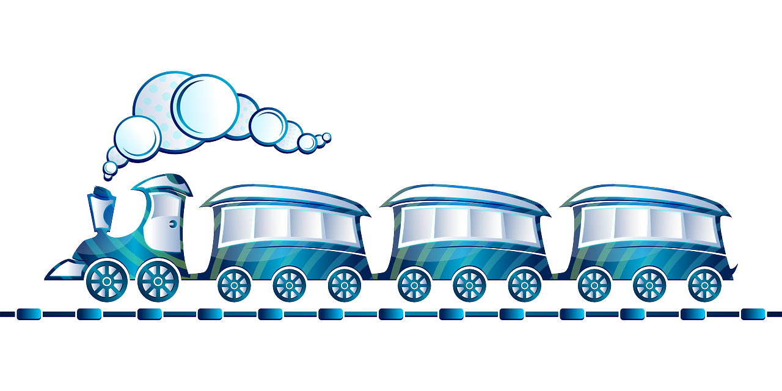
ROUTING
Data is routed by packets
Data packets contain different information about the file
The route is not always obvious
A router helps the data to “travel”
The route an be changed

Slide 10
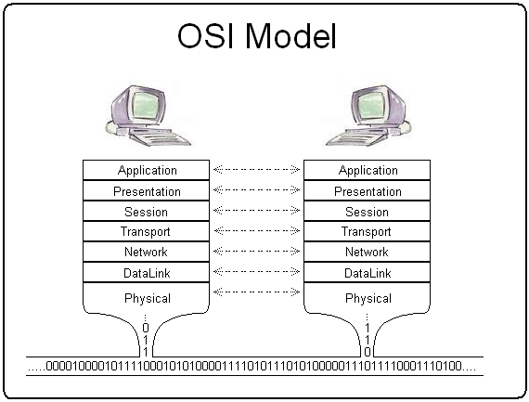
OSI MODEL
A reference model used by computer networks
Communication model for digital products
References behavior of protocols at different levels

Slide 11
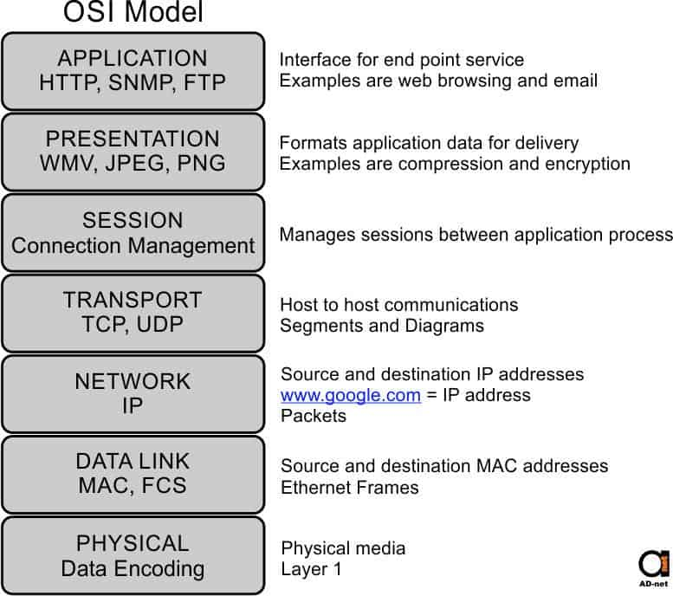

Slide 12
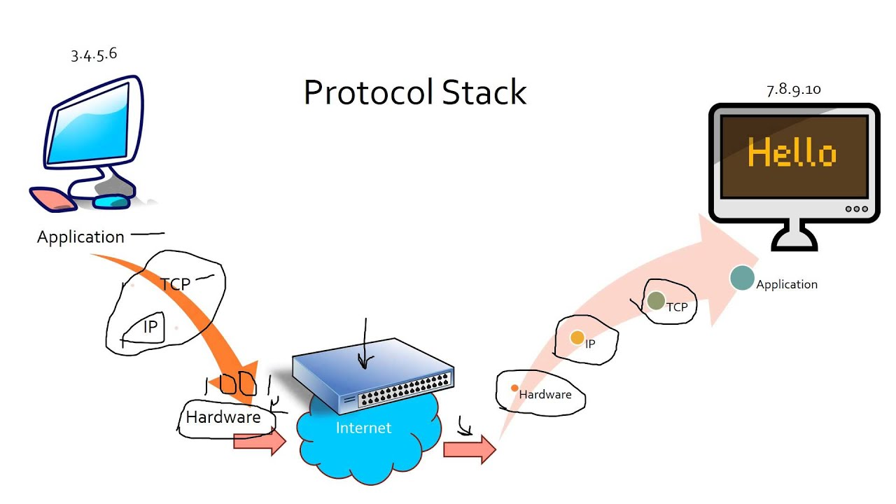
The internet does not have to function as a client-server model

Slide 13

A server-oriented program for web-servers, in the memory of which, the web-pages are contained

Slide 14
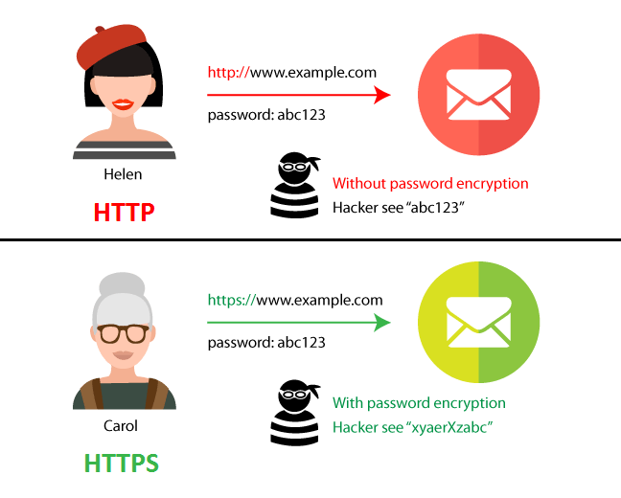
HTTP/S

Slide 15
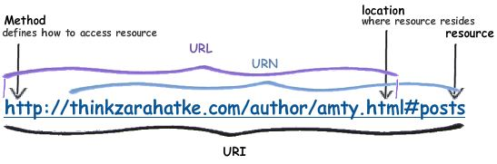
URI/URL:
Identifies a website / file / mailbox...

Slide 16
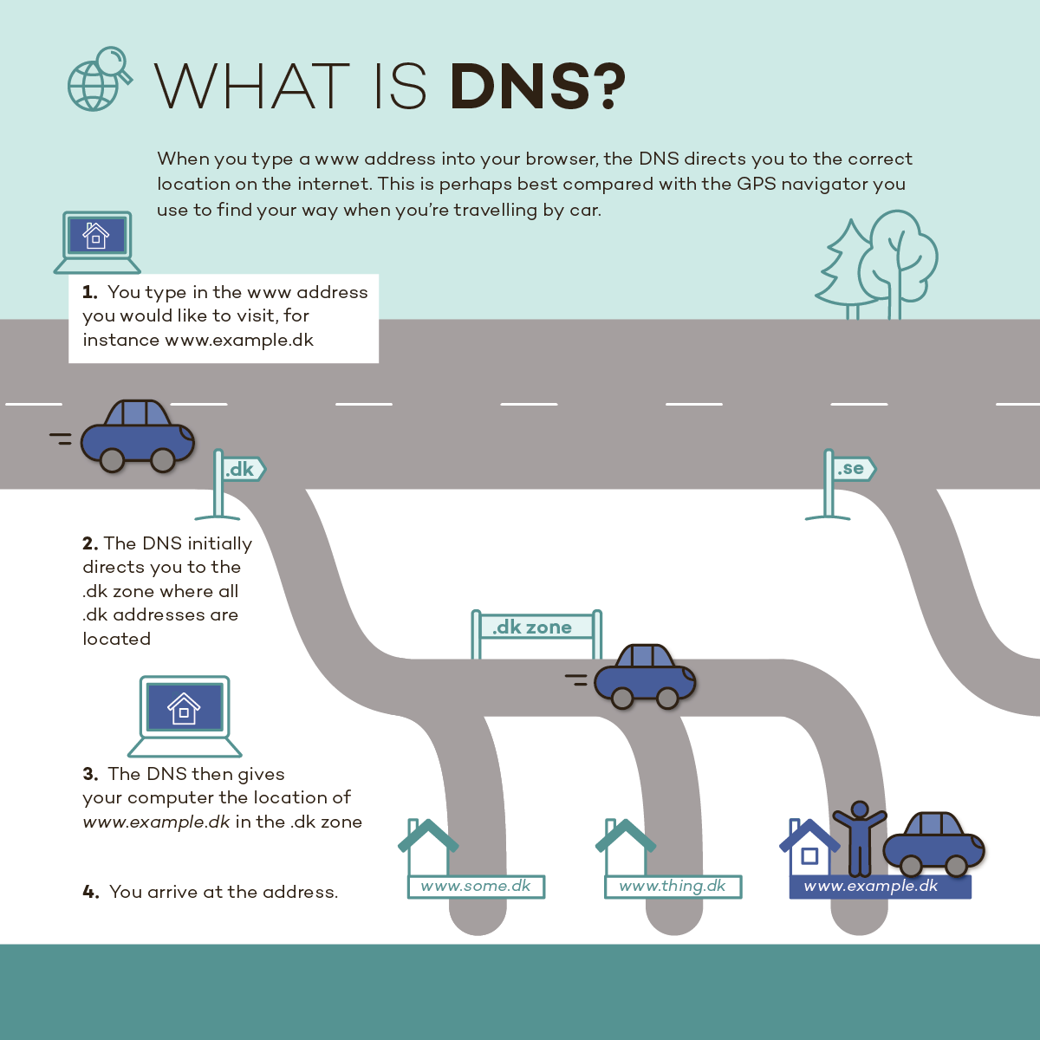
DNS

Slide 17
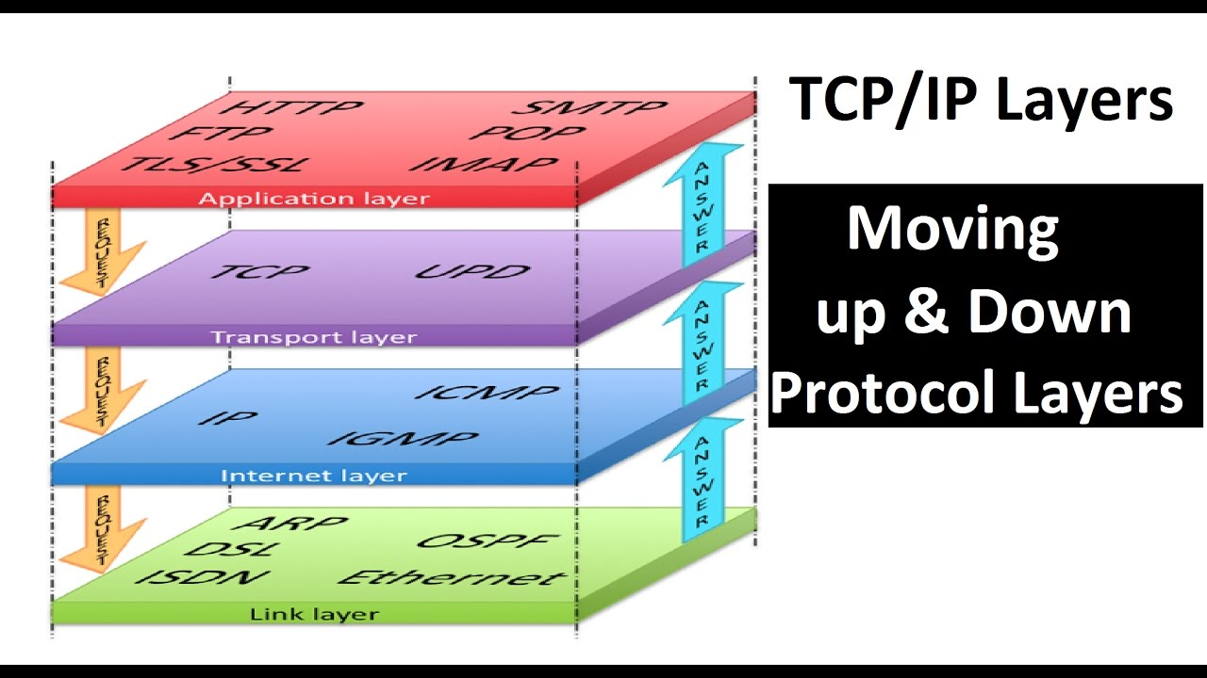
TCP/IP

Slide 18
TCP
IP
A set of rules that solve the problems of routing data on which the internet is based
Transport layer. Disassembles and reassembles packets of data. Responsible for communication
Network layer. Delivers packets of data. “Makes” it all - one big network

Slide 19
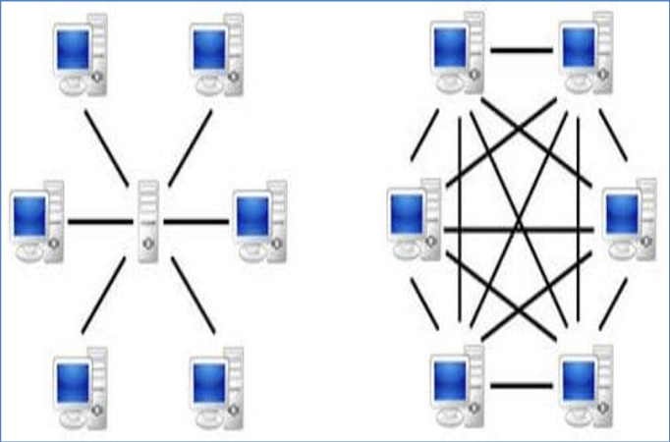
P2P
Equal nodes

Slide 20
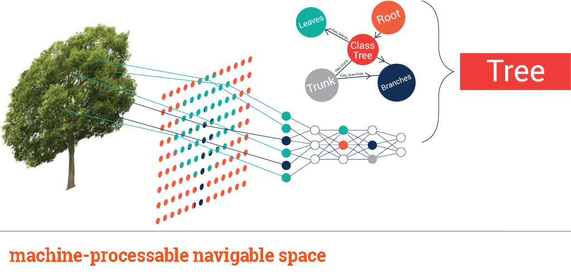
The semantic web:
Input > correlation > Output

Slide 21
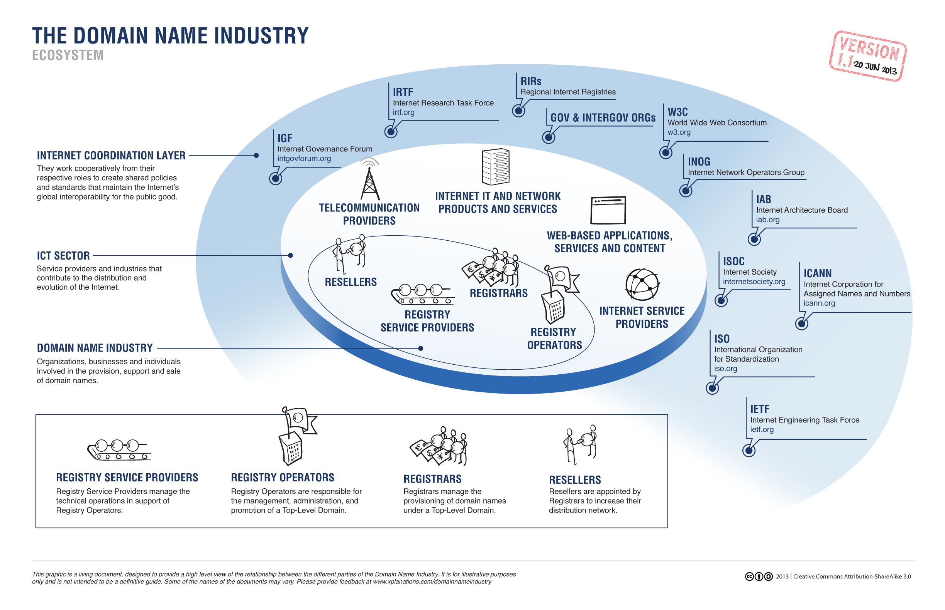
ICANN

Slide 22
Are the current standards “fair and safe”?
Centralised top level domain registries
No interest in solving security issues
Data selling without permission
Small group of beneficiaries
Unpredictable loss of data

Slide 23
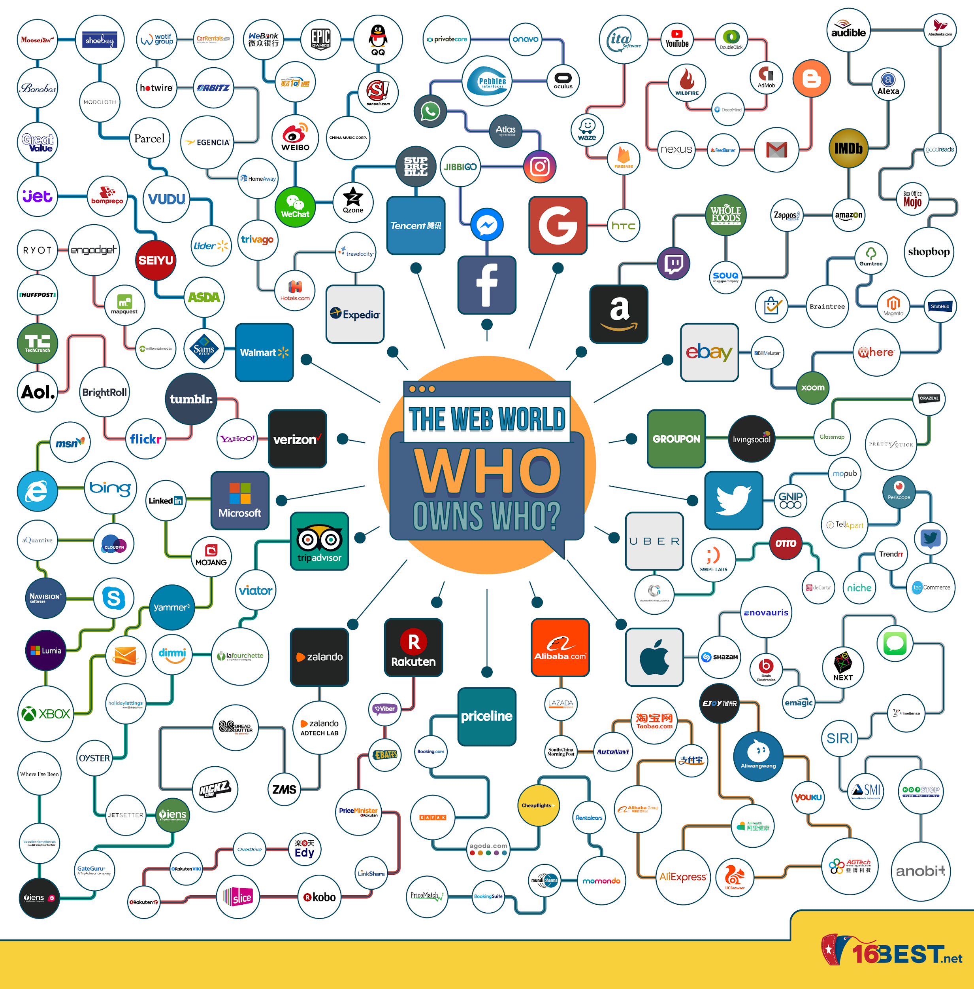
Who runs the internet?

Slide 24
A vicious cycle, which was not seen, even in Dante's worst nightmares.
Broken cycles
HTTP - URL - DNS

Slide 25
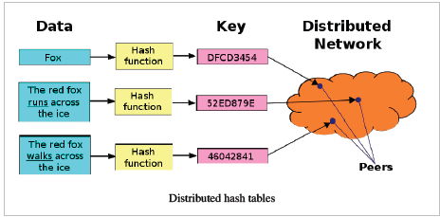
DHT can be used as infrastructure for P2P networks
DISTRIBUTED
HASH TABLE

Slide 26
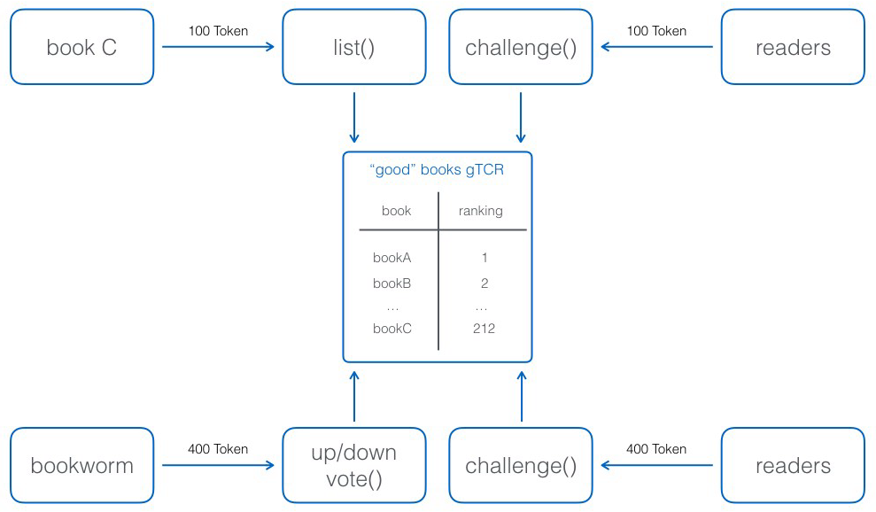
TOKEN CURATED REGISTRY

Slide 27
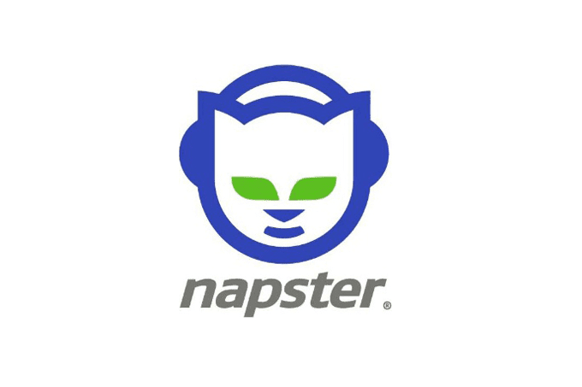
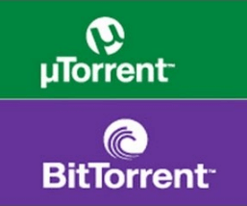

Slide 28
Learn more about protocols:
Database management systems
Cryptography
Computer networks
Data transmission
Local operating systems
Routing
Network fundamentals Please note that there are plenty of free online resources... like blockgeeks.com =)

Slide 29
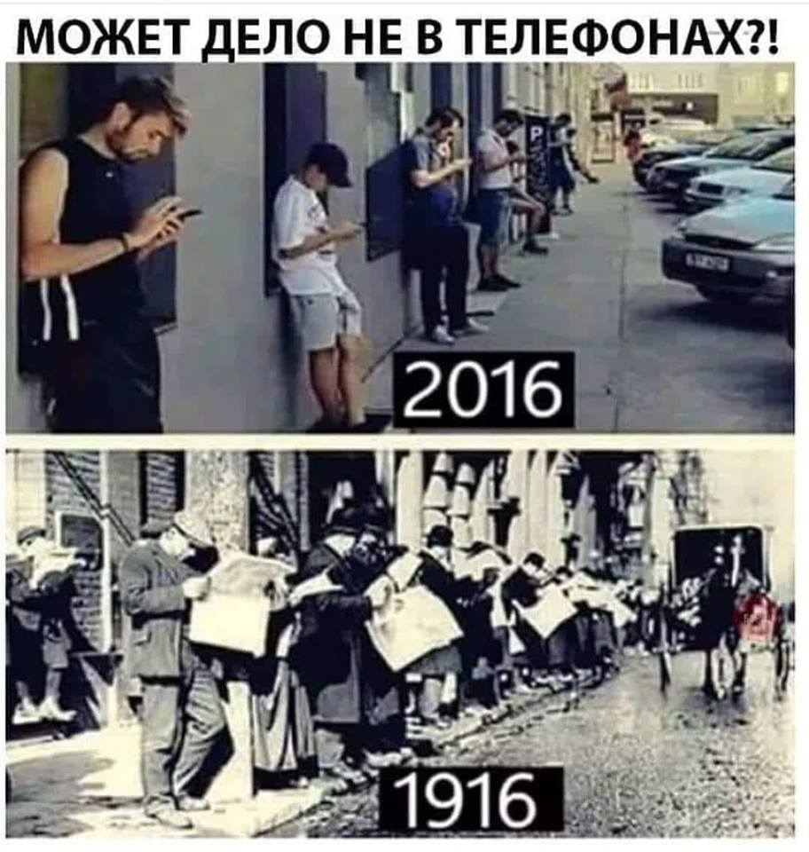
Have we seen this before?

Slide 30
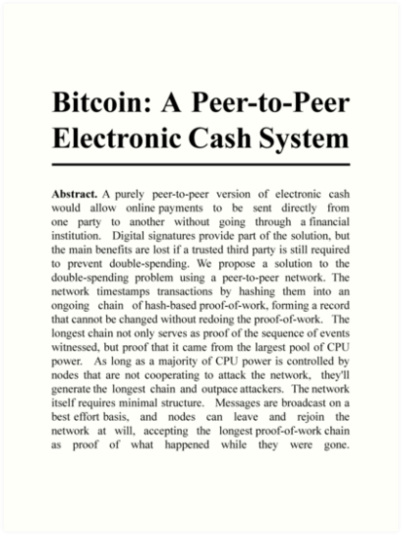
WELCOME TO THE BLOCKCHAIN
Money protocol
Governance issues
Consensus mechanism

Slide 31
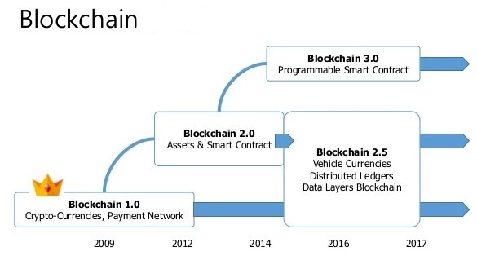

Slide 32
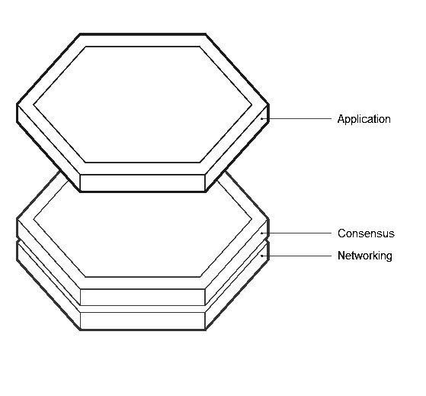
Blockchain 1.0: layers are “glued” together
Blockchain 2.0: a virtual layer for applications
Blockchain 3.0: inter-communication

Slide 33
The development of what once upon a time was just a mere search via a centralized server that connected a network of peers, to highly efficient, decentralized networks and on-line storage facilities, with motivated nodes, that are cooperating with each other in a coordinated manner with the help of code.
Their direct (no third party involved) coordination and cooperation between each other, a direct and obvious motivation of the user and the node, the coordination of actions with the help of smart contracts and the safe routing of packets and data, etc.

Slide 34
Centralization
Тechnological slowdown
Propaganda
Politics
Blunt-end servers
Geopolitics
Lack of privacy
Loss of data
Selling data to third parties
Web 2.0 Issues

Slide 35
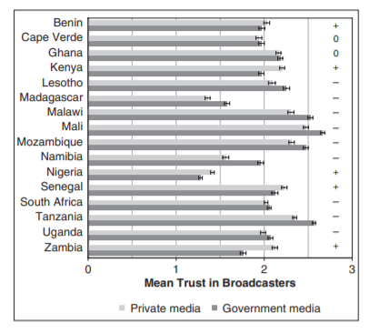
“...conventional wisdom says the Internet is making information more widely available, but that it also may be reducing the quality of that information…” “...perhaps something close to the opposite will be true: more high-quality information will exist, and it will be produced by more well-trained…” Source: Columbia Journalism Review

Slide 36
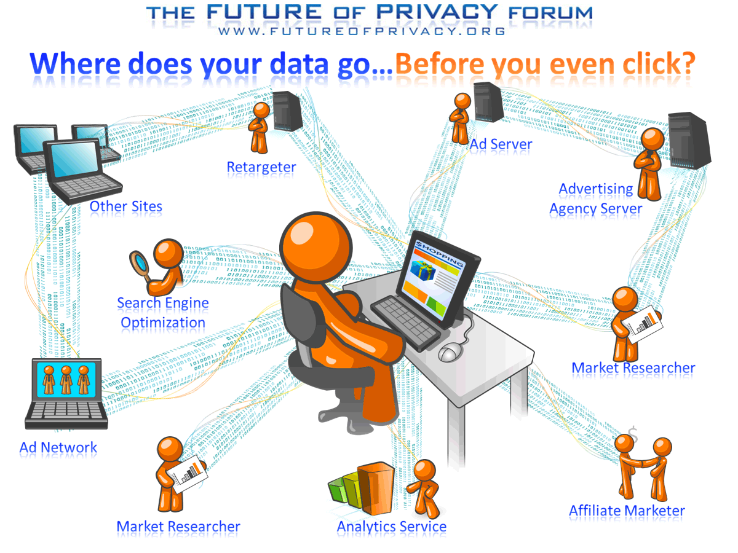
It’s not that simple

Slide 37
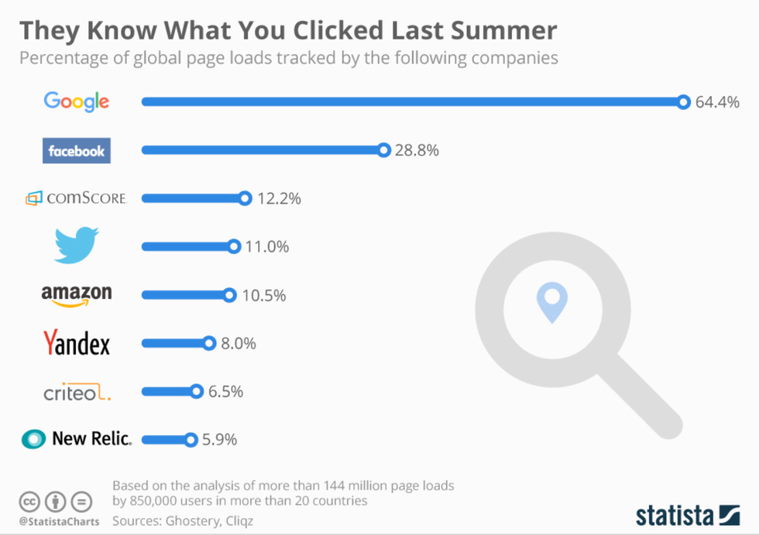
Name, sex, date of birth, profession, education, interests, preferences, what makes you angry, what makes you happy, when you watch movies, what you like, your heart beat rate, your location, your phone book, your texts and messages, your work and home address, your day schedule, where you rest, what you search for, what websites you visit, what you did in the past days \ months \ years, what you have in your apartment, where and what food you buy, what you buy in general, what you hate, who you talk to and when, who are your relatives and what do they do, your psychological profile, your voice, your friends, what you see before you, what makes you tick, your “secret” searches, the fact you are watching this webinar right now...
Cambridge Analytica - 5000 data points per US citizen...

Slide 38
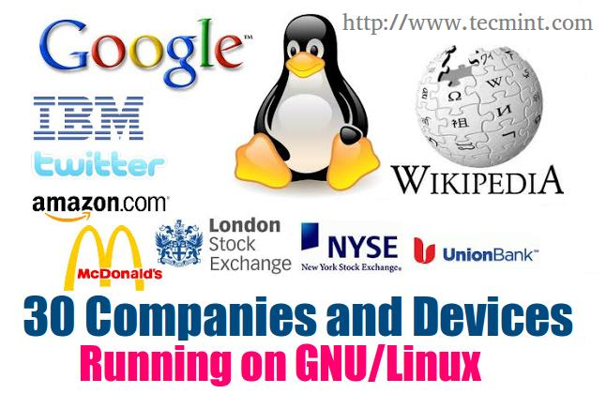
Success VS Market Cap
Internet VS LINUX
Success VS reach
Some UNIX systems around the world:
Supercomputers, NASA, robotics, gaming consoles, the Android collider, smart TV’s, Smart watches, Instagram, Airbnb, Uber, Netflix, car electronics, avia-systems, cars without drivers, washing machines, refrigerators, high speed trains, NY stock exchange, US defence sector systems, nuclear submarines, you PC...

Slide 39
ECB
Banking crisis
Independent CB
CB schemes
US FRS
BTC protocol has been working 10 years non-stop
Princess of the Yen
Globas Web 2.0 issues
Web 3.0 gives us leverage. It offers us an irreplaceable, a borderless and a fair technology. A technology based on math and on unstoppable and smart code. A technology that can fit into the pocket of any human beings, for as little as 20 Euros and create a personal CB (i am referring to the cost of the cheapest smartphone with an access to the net of course). Blockchain (which is part of the web 3 stack) is the internet of money. It is not just a database. Yes, it is a mix of technologies, which are long known to humanity. But with it, it is a paradigm that can help us to male everything around us a little better. Allow us to create distributed value, passive income and have leverage on local governance. (I am intentionally saying local, as i believe that we should look from local - to - global and not the other way around).

Slide 40
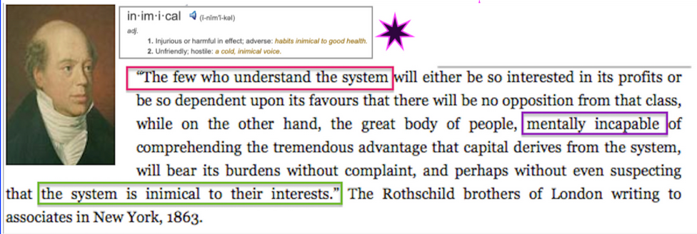
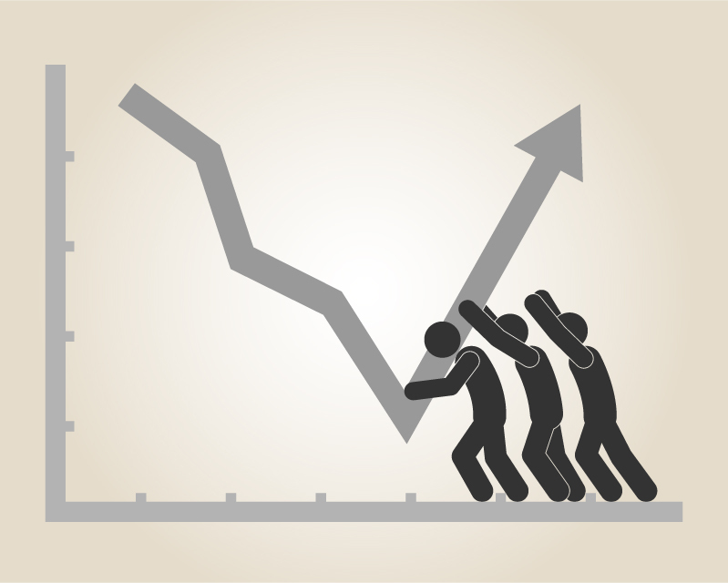

Slide 41
Offline browsing
Local caching of data
Local service points
Connection speed
Reputation
Token Curated Registries
Anonymous, yet provable ID
Mining and service providers
IPFS
Indexing of data
Algorithms
Decentralization
Consensus
Rebuilding the world wide web

Slide 42
MINING, and here I mean it in the broad sense of the word (from POW to DPOS): Is the type of global support for distributed networks. I am more than sure of it that soon enough (in fact it's already happening), we will see how miners become providers. This will allow them (the miners) for a whole bunch of operations that can provide them a source of income (an incentive to act). Those could be: sharding, data security, reading of data, oracles, on-and-off chain transactions, bandwidth, computation and so on. And - yes, mining is the new type of providers in web 3.0, that allows each user of the stack, to become one, develop, invest his time or money and to receive rewards.

Slide 43
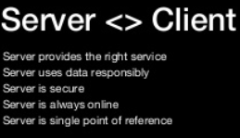
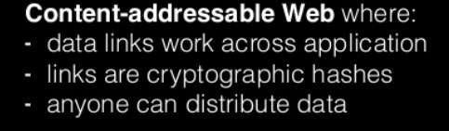
Content Addressing

Slide 44
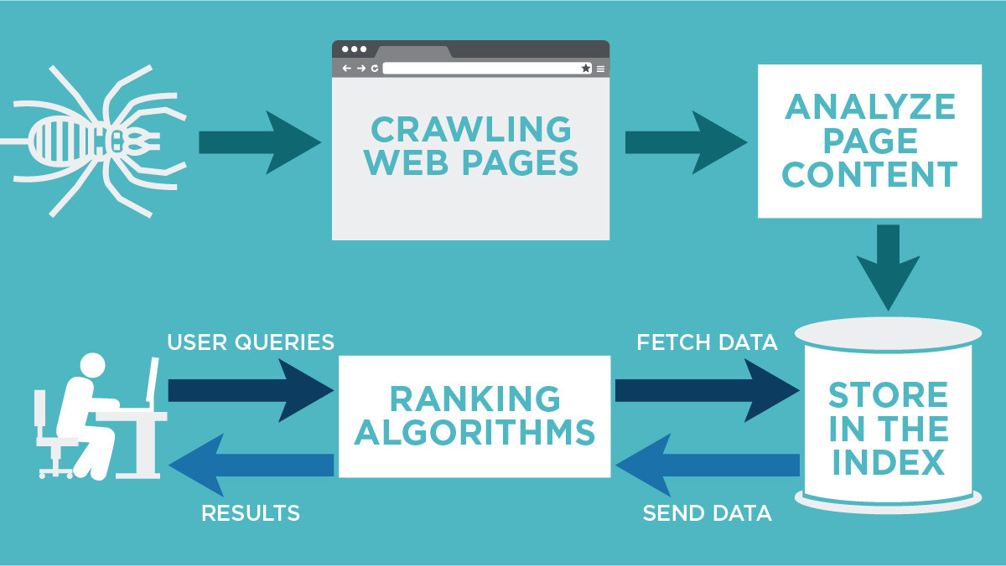
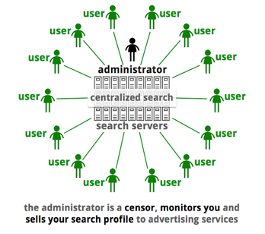
Ranking and Indexing
Or...

Slide 45
P2P-networks
Pseudo-web 3.0
Pseudo-P2P
Pseudo-cryptocurrencies
Technologies built on the base of web 2.0, will suffer from the same issues as web 2.0
In the third version of the web, the browsers the code, the applications and the software - will all talk to each other directly; and at first - might not look like, what we expect them to look like

Slide 46

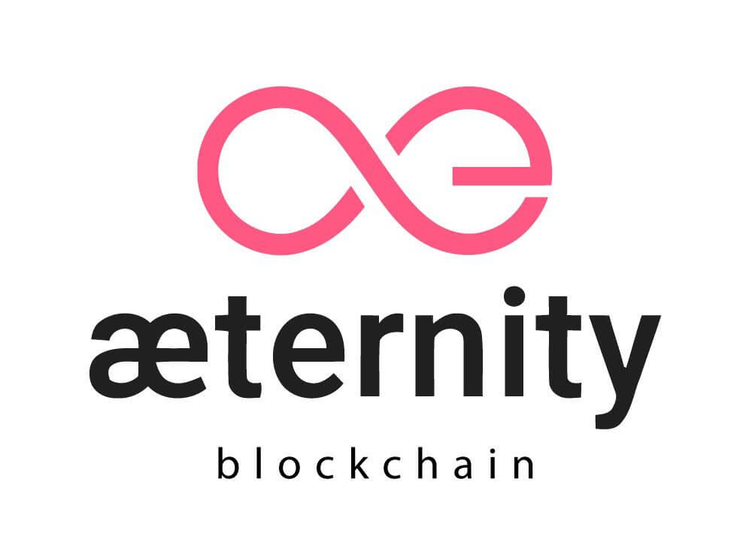

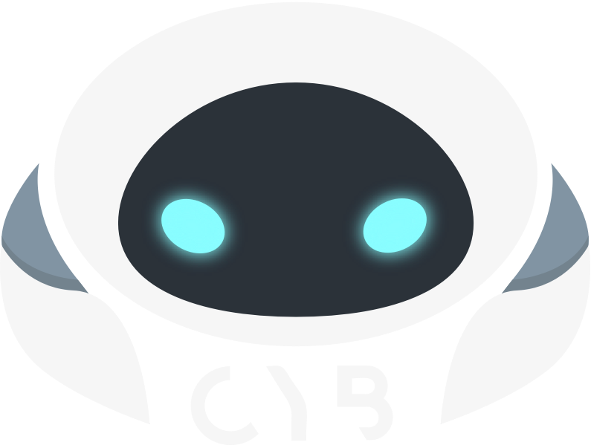

Aeternity
Cyb
PolkaDot
Holochain
Skycoin

Slide 47
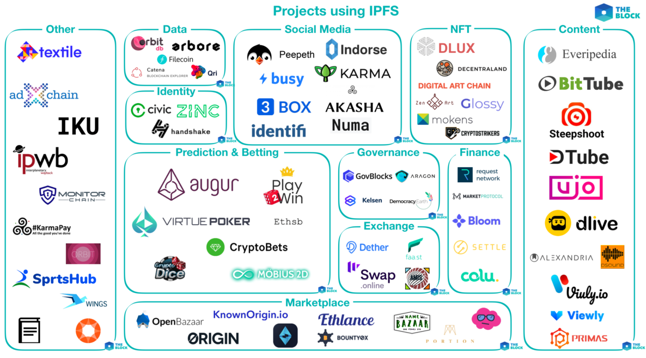
IPFS

Slide 48
IPFS
The Killer App?
Eliminate ISP’s
No need for an “online status”
Direct and secure P2P content sharing
No 404
No lost connections
Better organised clusters of storage
Immutable links
Mass adoption on the application level

Slide 49
Governance and consensus mechanisms
Smart contracts, IoT and robots
New types of organisations
Imagination is your only border
Aiming higher

Slide 50
Governance and consensus mechanisms: - Solution to the Byzantine Generals problem - Participants make the decisions (as opposed to “the ruling elite”) - Reaching agreement via a consensus - Use of fair and transparent voting and reputation - Creating new governance formalisms
Aiming higher

Slide 51
Smart contracts, IoT and robots: - Programmable contracts for anything without human intervention - Robots own money, just like humans do - IoT creates endless possibilities for local markets with the use of immutable ledgers
Aiming higher

Slide 52
New types of organisations: - Aragon / Gitcolony - No bureaucracy, no middlemen, no borders - Fairer courts; fairer decision making; fairer accountancy - Maths and code at the heart (rather than private and closed to public paperwork)
Aiming higher

Slide 53
Technology
Free thinking
Innovation
New paradigm
Ease of access
Privacy
Rewards
Transactional relations
Collateral
Scaling
Borderless
Growth
Centralized VS Decentralized

